Slide 1

Digital Copyright and the New Laws: What do they mean for you?
Naomi Korn
Copyright
Unless otherwise stated, the contents of this presentation are © Naomi Korn. This presentation may be shared and reused for non-commercial purposes, apart from any images, for which separate permission from Naomi Korn to reproduce them must be sought.
Where indicated, this presentation also includes content and slides which are copyright of third parties. In these cases, the terms of any licences must be honoured and where required, permission to reuse should be sought.
Disclaimer:
The information provided within this presentation is an opinion and should not be construed as legal advice.

Slide 2
What we are going to do today?
Take a small quiz
Set the scene
Examine new legislation, proposed legislation and case law
Look at their impact on your work
Relate the changes to your existing licences
Map some next steps
Answer some questions

Slide 3
Can you do this without permission?
Post someone else’s content on the Internet (website/blog etc)?
Post someone else’s content on your VLE/Intranet?
Format Shifting someone else’s content ?
Share someone else’s content with your friends?
Share someone else’s content with strangers?
Create a site for sharing other people’s content?
Use someone else’s content “educational purposes”?
Use someone else’s content for parody/satire?
Use for research or private study?

Slide 4
Yes or No?
Posting content on the Internet (website/blog etc)? UNLESS YOU CAN JUSTIFY UNDER AN EXCEPTION
Posting content on your VLE/Intranet?
UNLESS YOU CAN JUSTIFY UNDER AN EXCEPTION
3. Format Shifting NOT YET!
4. Sharing with your friends?
5. Sharing with strangers?
6. Creating a site for sharing?
7. Using for “educational purposes”? UNLESS YOU CAN JUSTIFY UNDER AN EXCEPTION
8. Parody/satire? NOT YET!
9. Using for research or private study?

Slide 5
Setting the Scene 1.
Speed of technological change
Speed of legislative change
Notes:
Speed of innovative use of technologies, vs. speed of legislative change

Slide 6
Setting the Scene 2.
Speed of technological change
Licences
Break the law/risk management
Don’t do it
Speed of legislative change
Notes:
Speed of innovative use of technologies, vs. speed of legislative change

Slide 7
Setting the Scene 3.
Speed of technological change
Licences
Break the law/risk management
Don’t do it
Speed of legislative change
Notes:
Speed of innovative use of technologies, vs. speed of legislative change

Slide 8

Lost in the Copyright Maze
Courtesy of Geograph: By Brian Robert Marshall
http://www.geograph.org.uk/photo/938546
Licensed under a CC BY SA
Notes:
Complicated – 1980’s applied to multimedia and technology of 21st century – laws based on propietary rights, but research produced collaboratively
Expensive – resources to manage rights and fees – paying several times over to create, access and use research papers
Restrictive
Preventing interoperability of data: access to content
Reducing opportunities, particularly innovation and growth

Slide 9
History of Hargreaves
Hargreaves’ report May 2011
Government response August 2011
Copyright Hub launched July 2013
New exceptions legislation expected Feb 2014
New exceptions June 2014
Enterprise & Regulatory Reform (ERR) Act - Royal Assent April 2013
More new exceptions due October 2014
Adapted from an original by Ben White, with kind permission

Slide 10
Hargreaves Review of IP: Key points
Steps to modernise copyright licensing
UK law to respond to changes in technology
Solutions for Orphan Works – single use and multiple
New Exceptions
Duration of © too long - should not be extended
Changes should be evidence based, rather than led by lobbyonics
Contracts should not over-ride copyright law
Notes:
Digital Copyright Exchange (DEC) – Recommendation 5. This will potentially stream-line the potentially onerous and costly tasks of tracing rights holders and rights clearance, faced by JISC funded projects such as the digitisation and OER strands, by making it easier for rights owners to be identified and then for them to licence their works more easilyto users. The Government has stated that the DCE will include Crown Copyright materials from day one. For users of the DCE, such as JISC funded projects, the DCE will potentially lead to cost savings in making it easier to locate rights holders and seek permissions to use their works. Works, such as Crown Copyright works, already licensed out under an Open Government Licence, and presumably other works licensed out under open content licences, such as Creative Commons licences, will then be more easily found – thus representing real cost savings for HEIs and FEIs.
7. Solutions for cross border licensing, potential regulation of collecting societies and proposed solutions for the use of orphan works (encompassed within Recommendations 3 and 4) will assist both mass digitisation projects, as well as single use of orphan works and thus open up access and use of important research and cultural heritage resources within parameters which recognise non-commercial use of the works, such as uses by JISC funded digitisation and OER projects.
8. The creation of a rafter of new exceptions to copyright as well as the implementation of the widest possible exceptions to copyright within the existing EU framework outlined with Recommendation 5 will lead to a wealth of benefits within the contexts of teaching, learning and research. Proposed new exceptions include:
- A new exception for data and text mining – which will revolutionise how researchers, industry etc can legitimately search, retrieve, process and connect data and text from potentially millions of publications on the internet, leading to the optimisation of research findings, greater innovation and growth.
- A new exception for parody- facilitating the legitimate use and creation of works which satire etc existing works. This will be poignant for JISC projects which may create or use parodying works, as well as felt more broadly within the contexts of teaching, learning and research
- A new exception for library archiving
- Widening the copyright exception for non commercial research to all classses of work for non commercial research, which will legitimize the reproduction of sound recordings and films, for example, for these purposes
- Other new copyright exceptions outlined within Article 5 of the Info Soc Directive 2001/29, such as the use [of a work in copyright] for the sole purpose of illustration for teaching or scientific research, as long as the source, including the author’s name, is indicated, unless this turns out to be impossible and to the extent justified by the non-commercial purpose to be achieved
9. Ensuring that current and future exceptions to copyright (such as the hugely important new proposed exception for data and text mining) are safe-guarded in law, by future-proofing the current legislative and regulatory framework as well as preventing the terms and conditions of contracts from over-riding the exceptions to copyright. This latter measure specifically, will rectify the current situations whereby:
- Academics and researchers may licence or even assign their rights to publishers in return for the publication, but at the same time, these agreements may often restrict them (and their institutions) from being able to use their works under the exceptions to copyright.
- Librarians and information professionals may find that the contracts accompanying the supply of their print and/or electronic resources, may also over-ride their entitlement to use these resources under the copyright exceptions.
- HEIs and FEIs may purchase blanket licences from rights holder representatives, which may either negate certain uses under the exceptions to copyright, and/or charge for those uses (as well as many others)

Slide 11
New Exceptions to Copyright 1
Accessible copies for disabled users
Fair dealing for instruction
Adapted from an original by Ben White, with kind permission

Slide 12
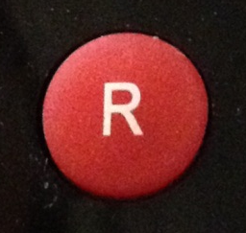

New Exceptions to Copyright 2
Recording of broadcasts for long distance learners
Copying and extract of works by educational
Establishments (non commercial 5% every 12 months)
Amended Library Privilege copying for patrons
Amended Library privilege copying for other libraries
Adapted from an original by Ben White, with kind permission

Slide 13

New Exceptions to Copyright 3
Library/archival preservation
Library copies of unpublished works
Making works available on dedicated terminals
Text and data mining – “Big Data” Exception
No override by contract
Adapted from an original by Ben White, with kind permission

Slide 14
What is Fair Dealing?
‘Fair dealing’ is a legal term used to establish whether a use of copyright material is
lawful or whether it infringes copyright. There is no statutory definition of fair
dealing - it will always be a matter of fact, degree and impression in each case. The
question to be asked is: how would a fair-minded and honest person have dealt
with the work?
Factors that have been identified by the courts as relevant in determining whether
a particular dealing with a work is fair, include:
Does using the work affect the market for the original work?
If a use of a work acts as a substitute for it, causing the owner to lose revenue,
then it is not likely to be fair.
Is the amount of the work taken reasonable and appropriate?
Was it necessary to use the amount that was taken? Usually only part of a work
may be used. The relative importance of any one factor will vary according to the case in hand and the type of dealing in question.

Slide 15
Accessible copies for disabled users
- S31
Before
After (expected)
Restricted to people with visual impairments only
Literary, dramatic, musical or artistic work
Contractual override
Dependent on no commercial copy being available
Widened to all impairments which prevent equal access
All types of copyright work
No contractual override
Requires TPM to be carried over in the copy too!?!?!?!
Adapted from an original by Ben White, with kind permission

Slide 16
Fair dealing for instruction – S32
Before
After
Instruction - Non-reprographic copying of literary, dramatic, musical and artistic works but … copying of film and sound OK (confusing)
Wide examination exception
Instruction – Any work, but must be fair dealing, non commercial, and applies to teachers and students who receive instruction
Not limited to educational establishments
Examination questions, and answering them narrowed to fair dealing ☹
However, no contractual terms override, therefore can be used over and above CLA/NLA licences!
Adapted from an original by Ben White, with kind permission

Slide 17
Recording of Broadcasts – S35
Before
After (expected)
Non-commercial educational use
‘Communication to the public’ premises limitation
Dependent on a licence from ERA
Non-commercial educational use
‘Communication to the public’ off premises via secure electronic network
Dependent on a licence from ERA (ERA+)
Adapted from an original by Ben White, with kind permission

Slide 18
Copying and Use of Extract of Works by Educational Establishments – S36
Before
After (expected)
Non-commercial
≤1% per work, per quarter, per institution
Covers LDM works
CLA licences take precedence
Non-commercial
≤5% per work, per year, per institution
Limited to educational establishments
Includes all works but not stand alone artistic works or broadcasts
Includes distance learning
CLA/NLA licences take precedence
Adapted from an original by Ben White, with kind permission

Slide 19
Library Privilege Copying to
Individuals S.42-43
Before
After
‘Prescribed’ libraries
Non-commercial research or private study
Article in a periodical or part of literary, dramatic or musical work
Declaration form
Patron must pay cost of supply
Contractual override
Publicly accessible or part of educational establishment
Non-commercial research or private study
All works
Reasonable proportion of “any published work”
Declaration still required but not through set form
If charged must cover cost of production
No contractual override (other than unpublished works)
Adapted from an original by Ben White, with kind permission

Slide 20
Library Privilege Copying for Other
Libraries – S41-42
Before
After
Supply of a journal article or whole or part of literary, dramatic or musical work
Includes illustrations in context
Not applicable if authorisation possible
Contractual override
Supply of journal article or whole or part of any published work
Any published work
Not applicable if authorisation possible
No Contractual override
Adapted from an original by Ben White, with kind permission

Slide 21
Library/Archival Preservation – S42
Before
After
Single (?) copy of item in permanent collection
Literary, dramatic or musical work
Includes illustrations and typographical arrangement
Contractual override
Reasonable copies of items in “permanent” collection
All types of copyright work including sound recordings, films and broadcasts
No contractual override
Adapted from an original by Ben White, with kind permission

Slide 22
Making Works Available Through Dedicated Terminals – S40B
New exception from 2001 EU © Directive
Relates to a publicly accessible library, educational establishment, museum or archive
Allows digitised collection items to be viewed on site through ‘dedicated terminals’
Research or private study
Query on ‘dedicated terminals’ definition – German case.
Lawfully acquired
Is made available in compliance with any purchase or licensing terms to which the material is subject
Adapted from an original by Ben White, with kind permission

Slide 23
Text & Data Mining – Big Data
New exception – a real “digital opportunity”
Use of algorithms to determine relationships in data
Non-commercial use (limited by EU © Directive)
Requires legitimate subscription/access to content to be mined
No contractual overrides
Sharing subject to the quotation exception OR if output not subject to copyright law N/A
Adapted from an original by Ben White, with kind permission

Slide 24
What is probably NOT Fair Dealing
Not using for the purposes outlined in the Exception
Unrestricted access i.e. not limiting to specific users or limiting their use
Making a high resolution copy available or one that could be seen to cause the owner to loose revenue
Reproducing the whole of something i.e. a whole book, a whole film
Case by case judgement……
Risk managed decision

Slide 25
When do the exceptions come into their own?
Not material covered by existing licensing schemes i.e unpublished text based works, documentary photos, documentary films etc
Material which is covered by licences for purposes not covered under the licences i.e: data and text mining
Slight overlap e.g.illustration for instruction purposes, BUT v. specific exception and MUST be fair dealing – still more limited than blanket licences

Slide 26
Is the CLA licence superfluous?
Absolutely not!
The majority of copying will still take place in HEIs and FEIs under the CLA Licence (published text based works for internal purposes)
The new exceptions in many cases legitimise gaps where there were neither licences nor exceptions
Now, most copying should be covered by a licence or an exception

Slide 27
What do they mean for you?
..it depends on who you are, what you have, and what you want to do
…….and your appetite for risk!!!!!

Slide 28
What we can expect! Quotation – S30
Before
After (expected)
Criticism & review did not cover ‘illustrative’ use
Works must already have been made publicly available
Widened to cover any reasonable quotation – must be “fair” and “proportionate”
Legitimises academic practice (citation & could cover teaching?)
Any work and must have been made publicly available
No contractual override
Adapted from an original by Ben White, with kind permission

Slide 29
SVENSSON
Currently available
Not new audience
No terms or conditions preventing linking

Slide 30
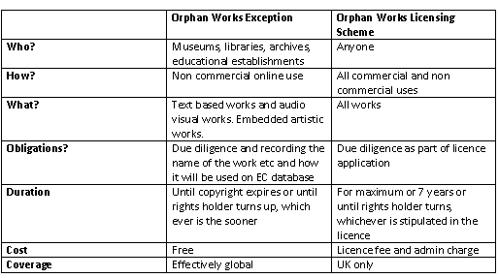
Orphan Work Exception vs. Licensing Scheme

Slide 31
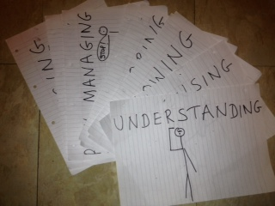
What You Need to Do Next
(In 10 Steps):

Slide 32

1. Understanding

Slide 33
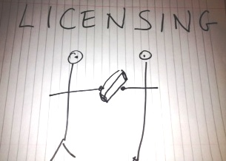
2

Slide 34

3. Knowing

Slide 35
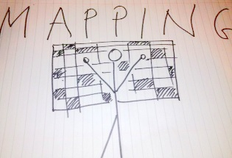
4

Slide 36
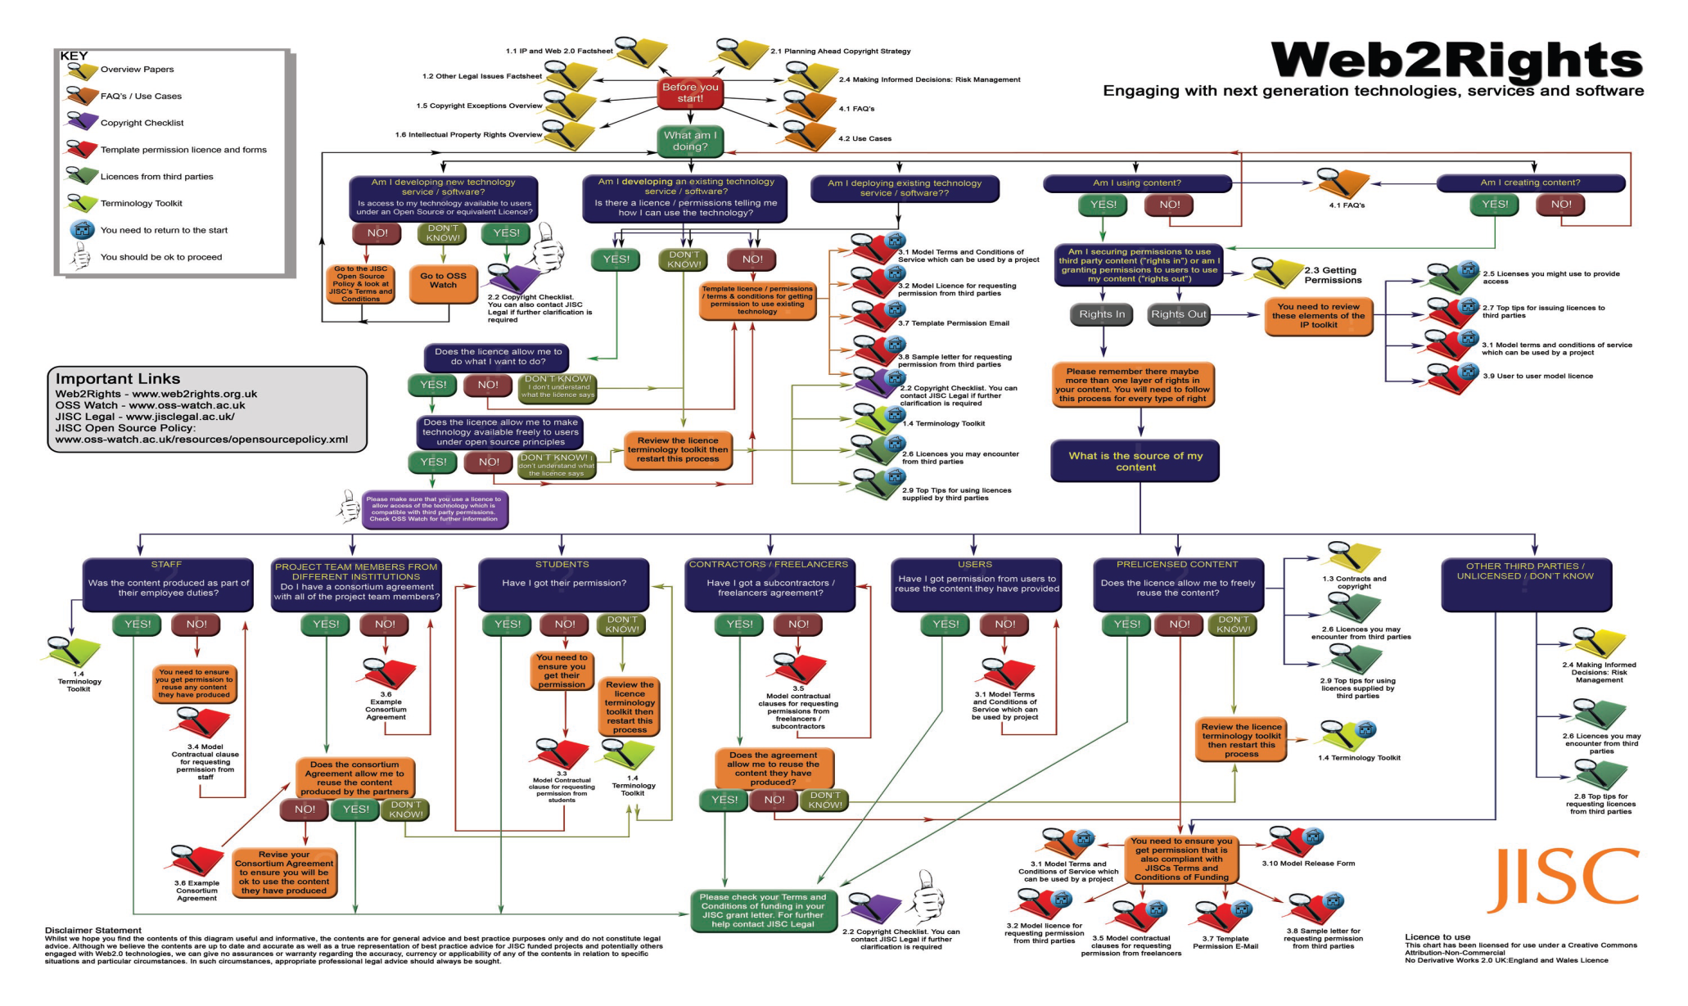
5. Developing

Slide 37

6

Slide 38
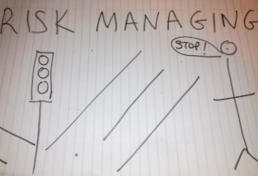
7

Slide 39
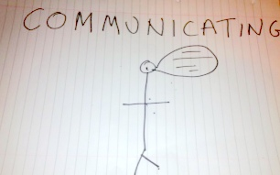
8

Slide 40
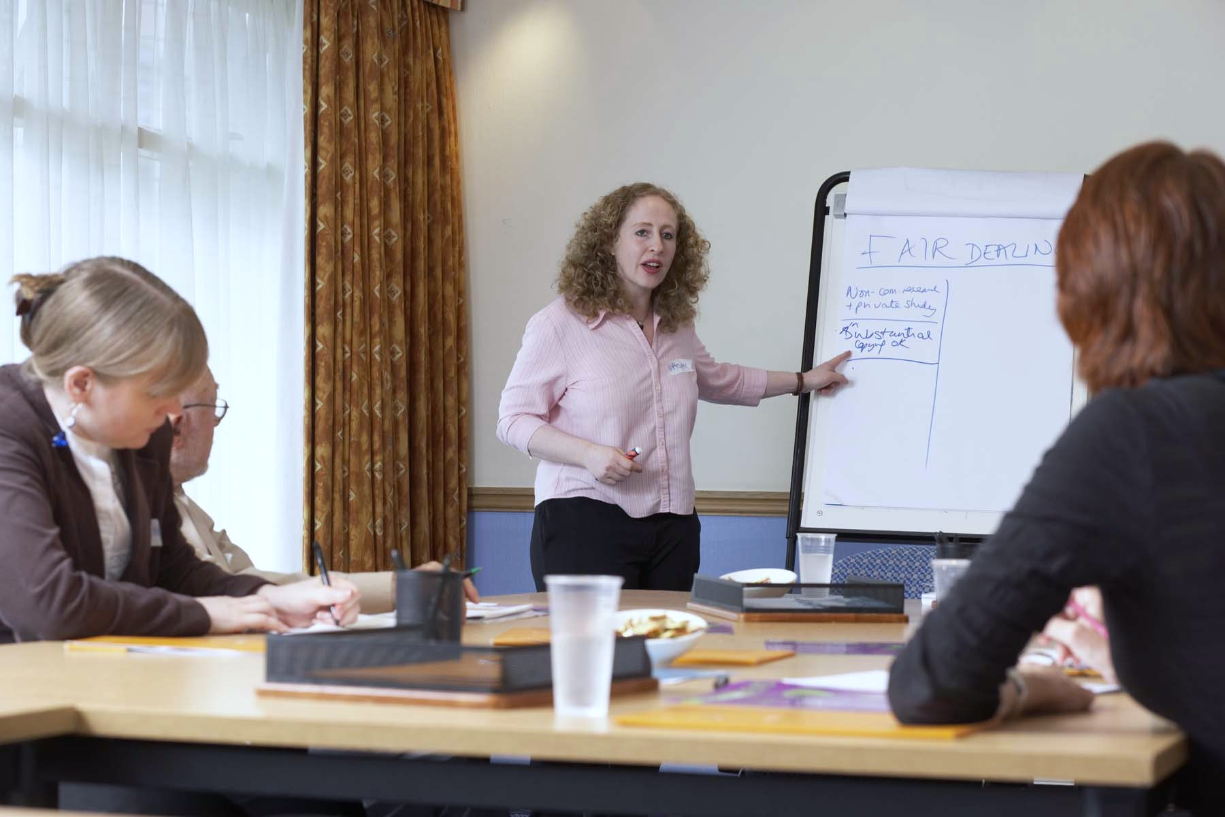
9. Training
© Courtesy of Alan Roberts

Slide 41
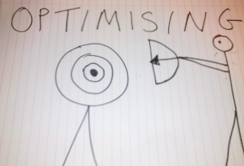
10

Slide 42
Thank you
www.web2rights.com
www.web2rights.com/OERIPRSupport
www.ipo.gov.uk
http://www.cilip.org.uk/cilip/advocacy-campaigns-awards/advocacy-campaigns/copyright/changes
copyright-law
http://www.jisclegal.ac.uk/ManageContent/ViewDetail/ID/3596/Questions-and-Answers--Copyright
Changes-2014.aspx
Thank you for listening
Any questions or comments?
For further information please contact me at…..
Naomi Korn
IPR Consultant
naomi@naomikorn.com

